Slide 1

Traffic Crash Characteristics and Injury Severity
Multivariate Data Analysis I 2024F BIA 652-A
Jithendhar Karukola
Renu Deepya Iska
Shriya Vaishnavi Gudibandi
Sai Narasimha Sama
Phani Kumar Kaithepalli

Slide 2
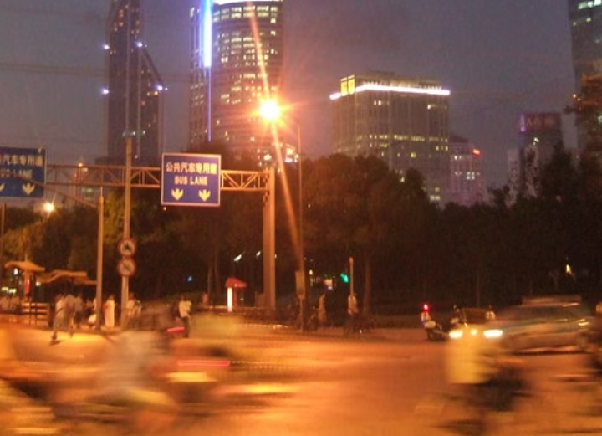
Background and Significance
Traffic Safety – A Global Concern:
According to the WHO, over 1.3 million people die in road traffic crashes each year globally.
An additional 50 million people are injured, leading to long-term economic and social consequences.
Traffic crashes are a leading cause of injury and death in both developed and developing countries.

Slide 3
Objectives of the Study
Primary Goals:
Investigate the relationship between city property damage and injury severity.
Analyze the impact of geographic distance and intersection type on injury outcomes.
Outcome:
Develop evidence-based traffic safety strategies and recommendations.

Slide 4
Dataset Overview
Data Source: Traffic crash records from San Jose, California (provided dataset).
Key Variables:
Injury Severity: Categorized into minor, moderate, and fatal injuries.
City Property Damage (CityDamageFlag): Indicates whether the crash involved city property damage (Yes/No).
Log-transformed Distance: Distance of crash location from a fixed reference point, transformed to reduce skewness.
Intersection Number: Represents the intersection types (e.g., T-junction, roundabout).

Slide 5
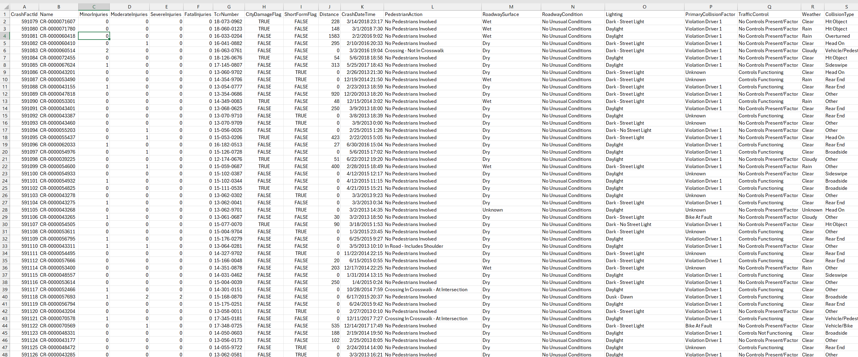
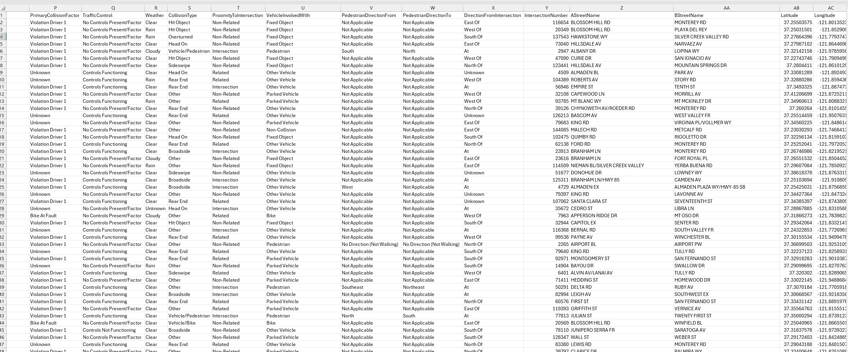
Dataset Overview Continued

Slide 6
Methodology Overview
Workflow:
Data Preprocessing: Clean the dataset by handling missing values, normalization, and transforming variables.
Factor Analysis: Use PCA (Principal Component Analysis) to reduce dimensionality and identify underlying latent factors.
Regression Analysis: Build models to predict injury severity based on independent variables (distance, intersection, etc.).
Cluster Analysis: Group crashes with similar characteristics to uncover patterns.

Slide 7
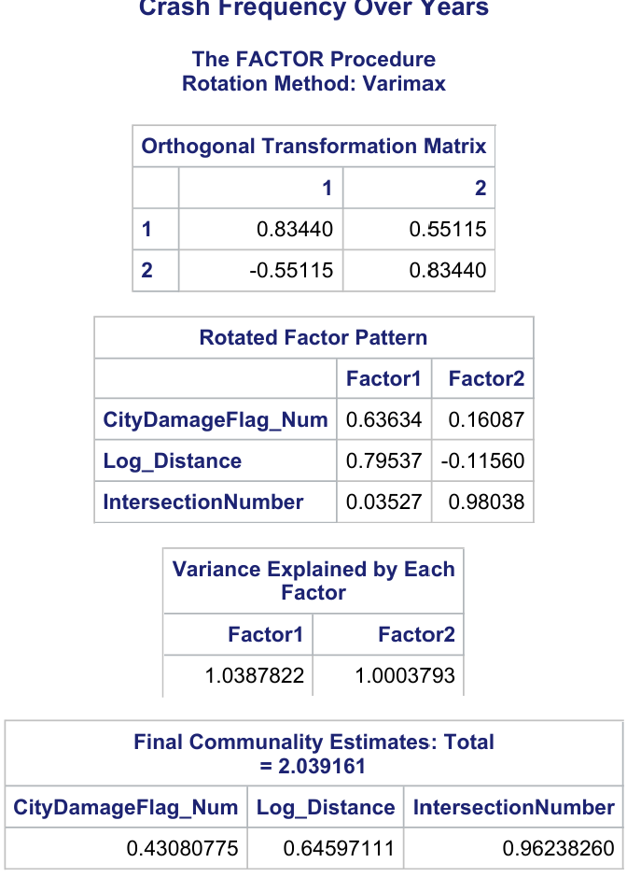
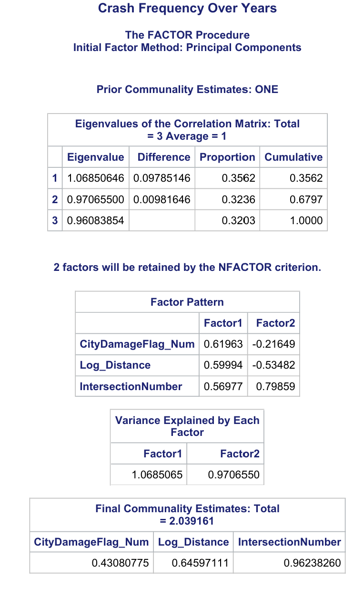
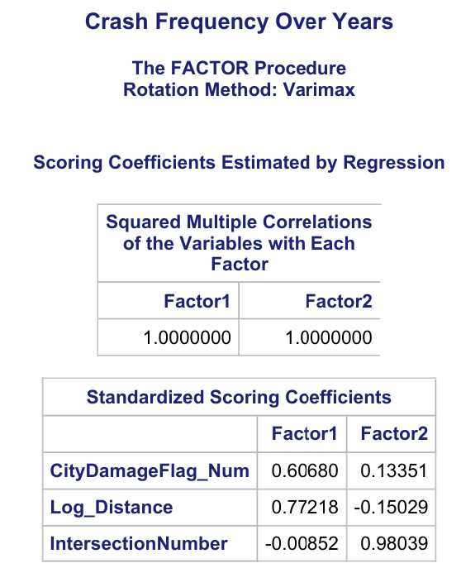
Methodology Overview Continued

Slide 8

Descriptive Statistics
Key Insights:
Injury Severity:
Minor injuries: 70% of all crashes.
Moderate injuries: 25% of crashes.
Fatal injuries: Rare, comprising just 5%.
CityDamageFlag:
7.37% of crashes involve city property damage.
Log-Transformed Distance:
Provides more normal distribution after transformation, reducing skewness.

Slide 9
Factor Analysis
Factor 1: Distance Factor
Utilized Principal Components method with Varimax rotation.
Retained two significant factors explaining dataset variance.
First factor, Distance Factor, strongly loaded Log_Distance variable with a loading value of 0.7954.
Factor 2: Intersection Factor
Intersection Factor: High loadings for IntersectionNumber, indicating unique injury severity patterns in crashes near intersections.
CityDamageFlag_Num variable: Relevant across crash conditions dimensions.
Total variance explained by factors: 2.039, with Factor 1 accounting for slightly more variance.

Slide 10
Multiple Regression Analysis
Regression Models:
Minor Injuries:
CityDamageFlag: Negative correlation (-0.2496, p < 0.0001).
Log_Distance: Negative impact (-0.0332, p < 0.0001).
Moderate Injuries:
CityDamageFlag: Positive correlation (0.1642, p < 0.0001).
Fatal Injuries:
CityDamageFlag: Positive correlation (0.0298, p < 0.0001).
Key Insight: City property damage increases injury severity, particularly for moderate and fatal injuries.

Slide 11
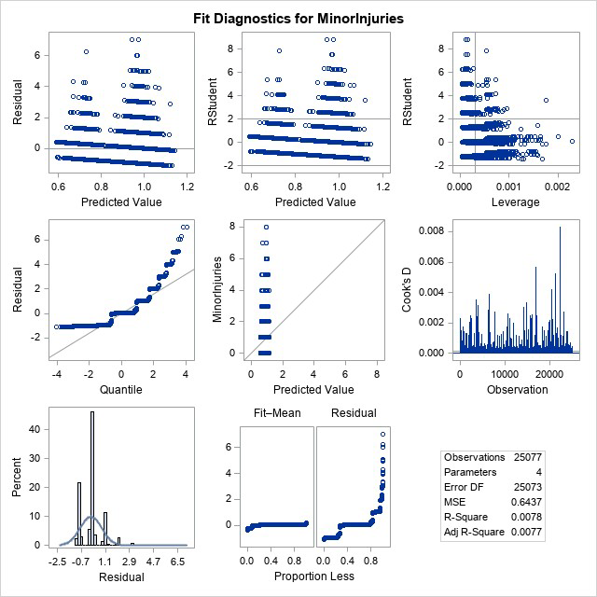
Minor Injuries Regression
City Property Damage
• CityDamageFlag\_Num variable shows negative correlation with minor injuries.(coefficient of -0.2496, p < 0.0001) • City property damage crashes less likely to cause minor injuries.
Geographic Distance
• Log\_Distance variable shows small, significant negative coefficient of -0.0332, p < 0.00

Slide 12
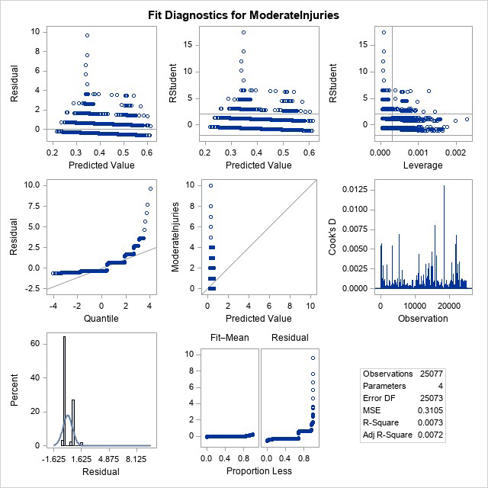
Moderate Injuries Regression
City Property Damage
CityDamageFlag_Num Predicts Crashes • Significant positive predictor (coefficient: 0.1642, p < 0.0001). • Increased likelihood of moderate injuries in crashes involving city property damage.
Geographic Distance
Log_Distance Relationship in Crash Probability • Positive correlation (coefficient: 0.0259, p < 0.0001). • Farther crashes increase moderate injuries likelihood. • IntersectionNumber not statistically significant.

Slide 13
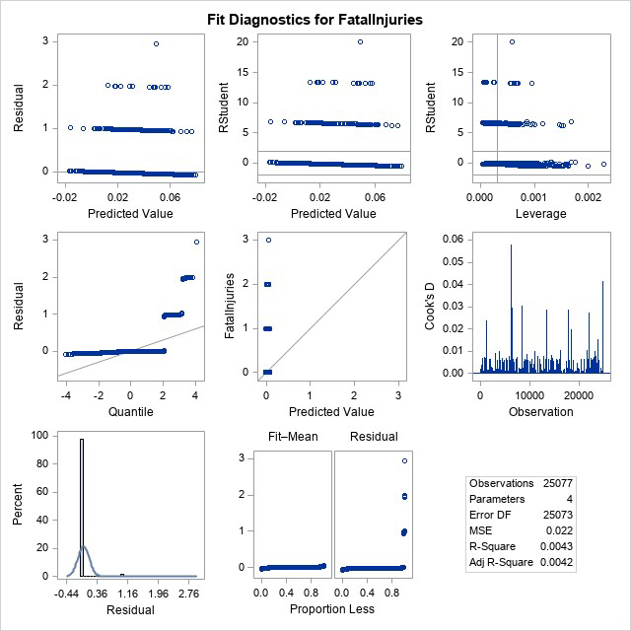
Fatal Injuries Regression
City Property Damage
CityDamageFlag_Num Variable Predicts Fatal Injuries • Significant positive predictor (coefficient: 0.0298, p < 0.0001). • Small effect size suggests slightly increased fatal injury likelihood.
Geographic Distance
Log_Distance and IntersectionNumber Models • Log_Distance shows minor role in predicting fatal injuries. • IntersectionNumber is not significant.

Slide 14
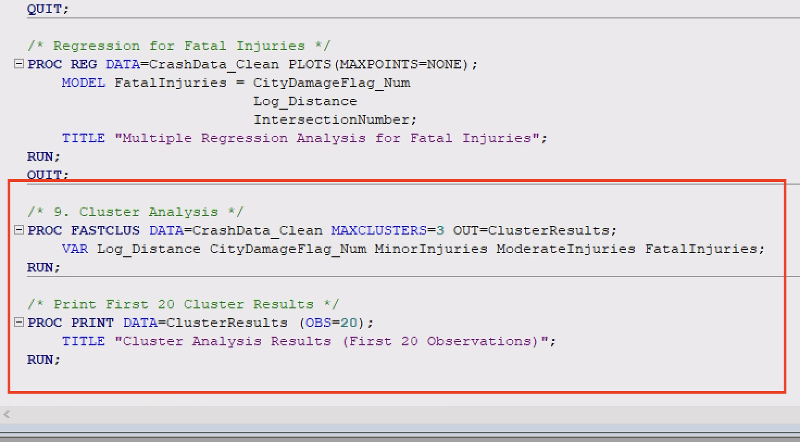
Cluster Analysis
Cluster 1: High Moderate Injuries
Cluster 1 is characterized by crashes with a high number of moderate injuries. The average Log_Distance for this cluster is 0.29, while CityDamageFlag_Num is positive at 0.13. The mean number of moderate injuries in this cluster is 4.62, indicating that this group represents crashes of moderate severity.
Cluster 2: Higher Minor Injuries
Cluster 2 includes crashes with a higher prevalence of minor injuries. The average Log_Distance is negative at -0.59, and CityDamageFlag_Num is slightly negative at -0.03. The mean number of minor injuries in this cluster is 1.79, making it distinct from the other clusters.

Slide 15
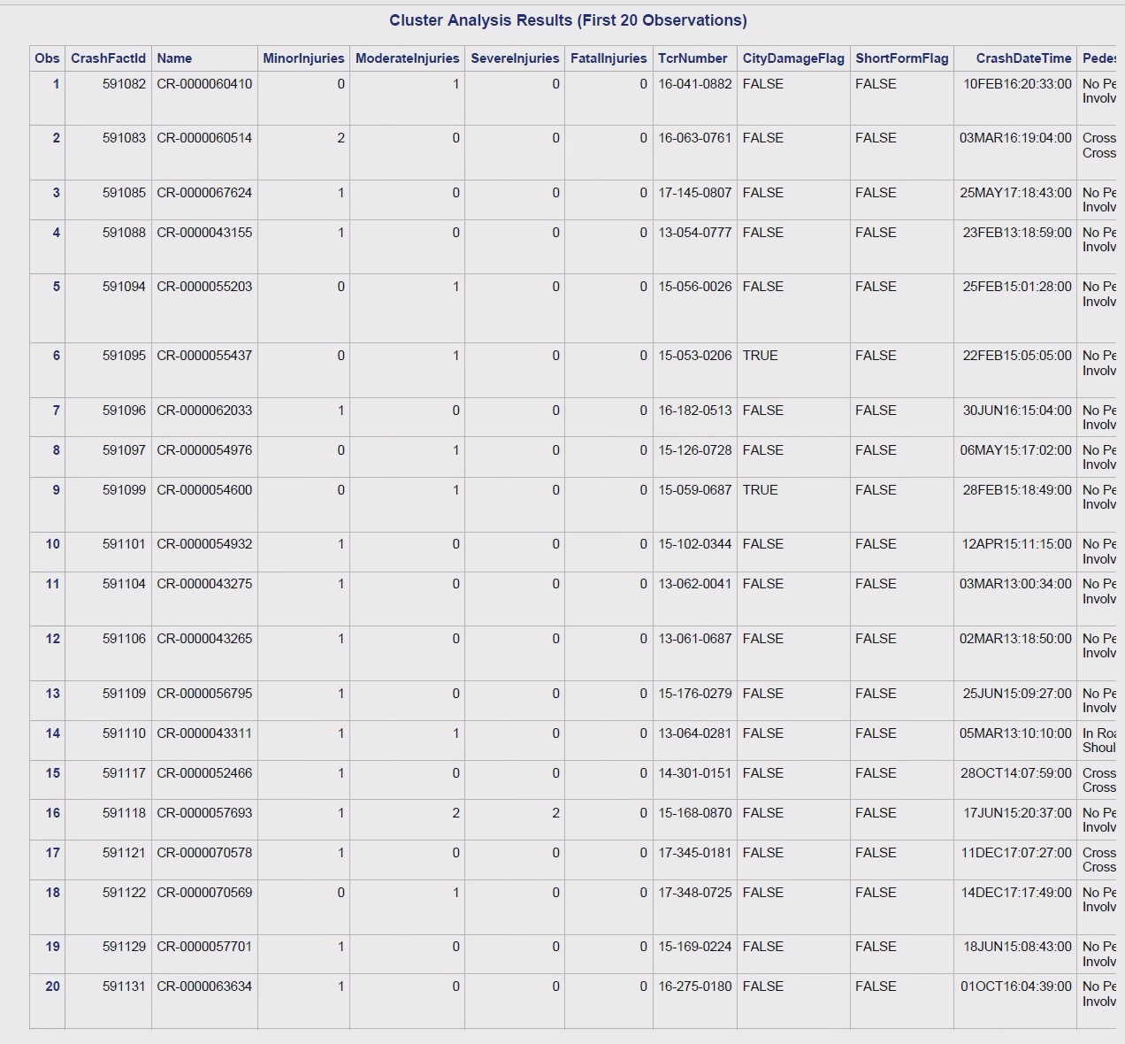
Cluster 3: Balanced Injuries
Cluster 3 represents crashes with balanced numbers of minor and moderate injuries. The average Log_Distance is 0.23, and CityDamageFlag_Num is close to zero at -0.02. This group has an average of 0.42 moderate injuries and 0.96 minor injuries.

Slide 16
Challenges and Limitations
Data Limitations:
Missing variables (e.g., driver behavior, speeding, weather conditions).
CityDamageFlag: Rare occurrence, making statistical models less robust.
Methodological Challenges:
Non-linear relationships among variables (requiring transformations).
Small sample size for fatal injuries, leading to less reliable results in certain injury types.

Slide 17
Key Findings
City Property Damage:Associated with higher injury severity.
Geographic Distance:Has a moderate but significant impact on injury outcomes.
Cluster Analysis:Reveals actionable insights for tailored safety interventions.

Slide 18
Recommendations
Policy Interventions:
Urban zones: Focus on high-severity locations and implement stronger safety measures.
Speed Enforcement: Prioritize areas with high-risk crash profiles.
Urban Planning:
Improve intersection safety (e.g., signalization, pedestrian crossings).
Implement property damage prevention measures.
Cluster-Specific Strategies:
Develop customized safety campaigns for clusters with high injury severity.

Slide 19
Future Directions
Data Enrichment:
Integrate speeding, driver behavior, and weather conditions into the dataset.
Consider longitudinal data to observe trends over time.
Advanced Models:
Implement machine learning models (e.g., decision trees, random forests) for predictive accuracy.
Explore real-time traffic monitoring for enhanced safety measures.

Slide 20

Conclusion
Summary of Findings:
Multivariate analysis has provided key insights into the factors influencing traffic crash severity.
City property damage is a significant predictor of higher injury severity.
The geographic distance and intersection type also contribute but to a lesser degree.
Final Thoughts:
This analysis serves as a foundation for future safety strategies and urban planning.

Slide 21
Thank you

